Slide 1
COVID-19 Twitter
NLP Analysis
Fernando Forero Acosta, Meghan Rokas, and Anna Willman

Slide 2
Executive Summary
01
Data Profile
02
Vaccine
Exploratory Data Analysis
TABLE OF CONTENTS
05
03
One Year Anniversary
06
Trending Topics & Sentiment Analysis
04
Women
07
Goal of the project
Describing the data and variables
Analyze sentiment towards COVID vaccines
Analyzing and plotting the data
Analyze sentiments on the one year anniversary of COVID
Use NLP to find the top 3 trending topics related to Covid-19 and the overall sentiment
Analyze sentiments towards how the pandemic has impacted women

Slide 3
01
Executive Summary

Slide 4
COVID-19
TWITTER
NLP
Twitter is a social networking service that users can share their thoughts with friends and followers. We have pulled tweets referencing COVID-19 in order to do a sentiment analysis.
The COVID-19 pandemic has been prevalent for just about a year in the United States. We are interested to see what the sentiment towards this virus is, now that we have been living with it for a year.
We used a variety of NLP tools to find the most discussed topics related to COVID-19. From these topics, we analyzed their sentiment and gained insights.

Slide 5
02
Data Profile

Slide 6
DATA PROFILE
3/8 & 3/11
#COVID19
34,081
12
Extraction Dates
Source Hashtag
Tweets
Feature columns

Slide 7
03
Exploratory Data Analysis

Slide 8
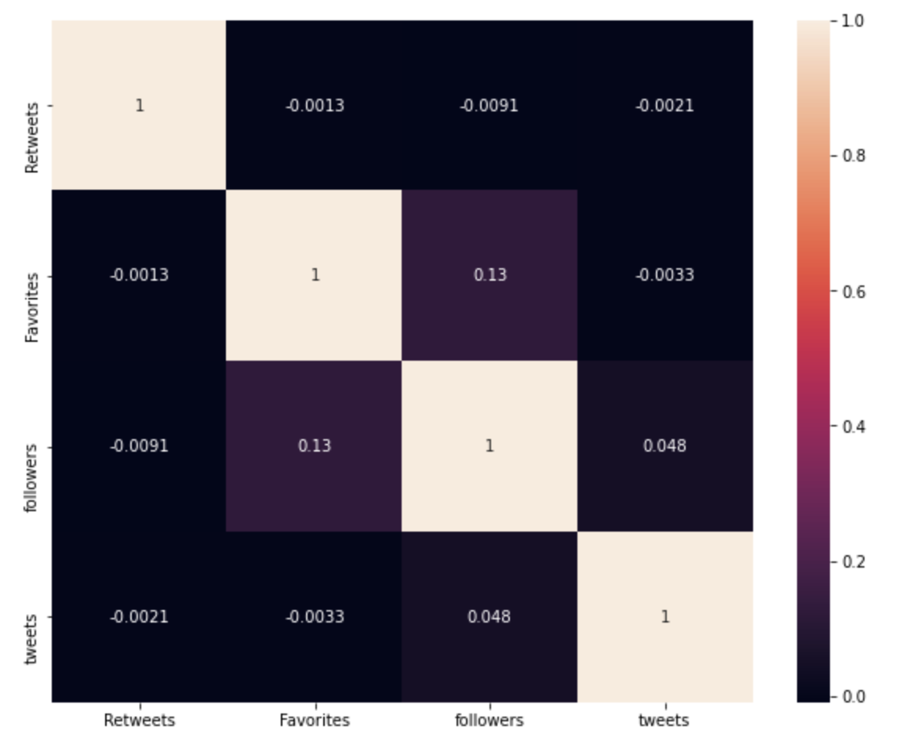
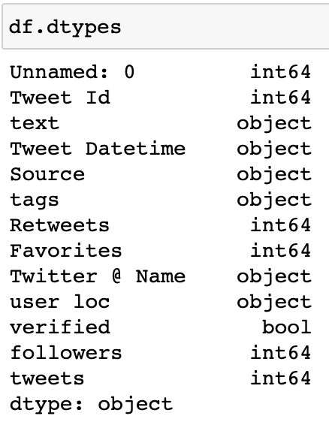
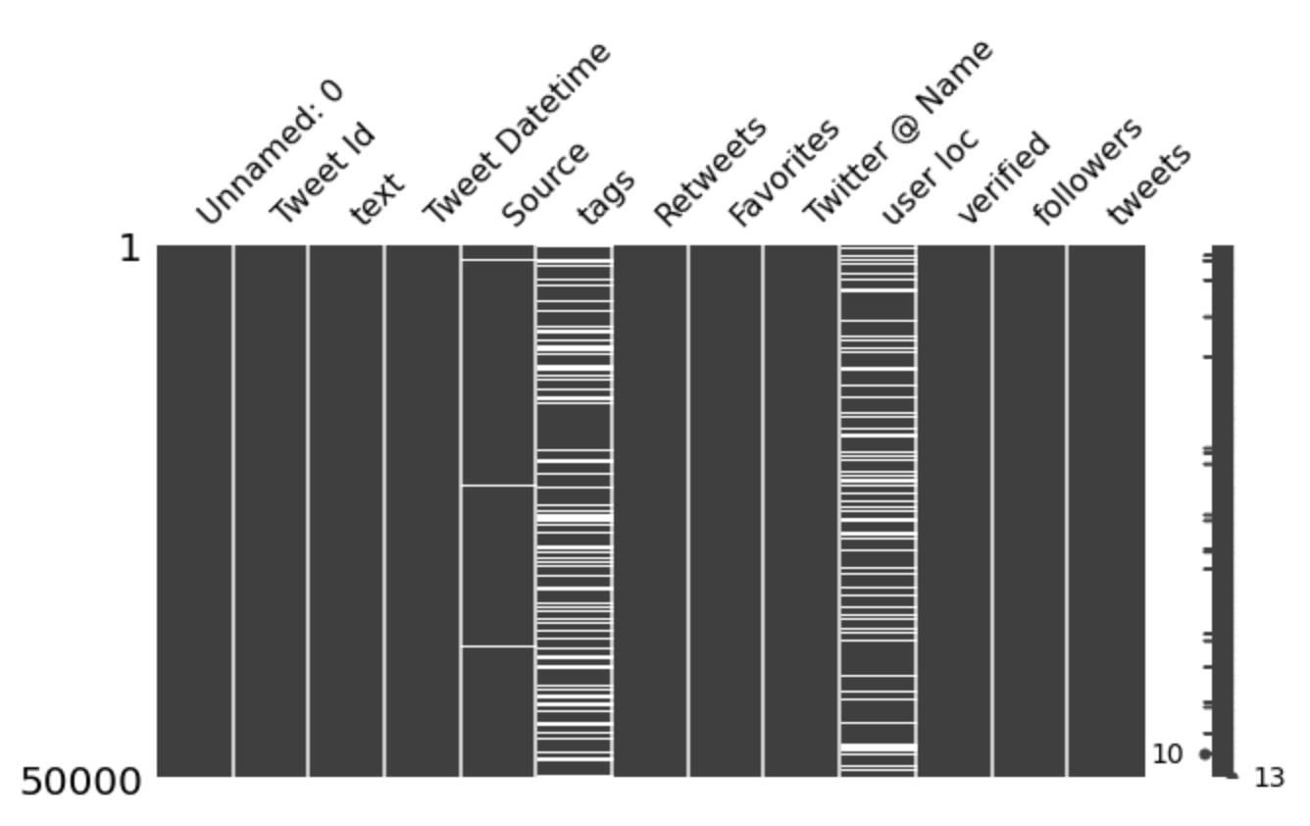
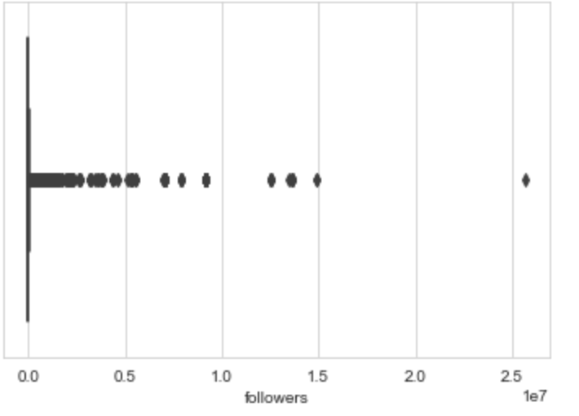
Data Types
Null Counts
Correlations
Limitations
Retweets caused duplicate tweets that needed to be dropped
Some tweets were truncated which led to missing hashtags
Only could extract data from one day at a time
Retweet and favorite counts are inaccurate due to not enough time lapsing after initial tweet
Box Plots

Slide 9
04
Trending Topics & Overall Sentiment

Slide 10
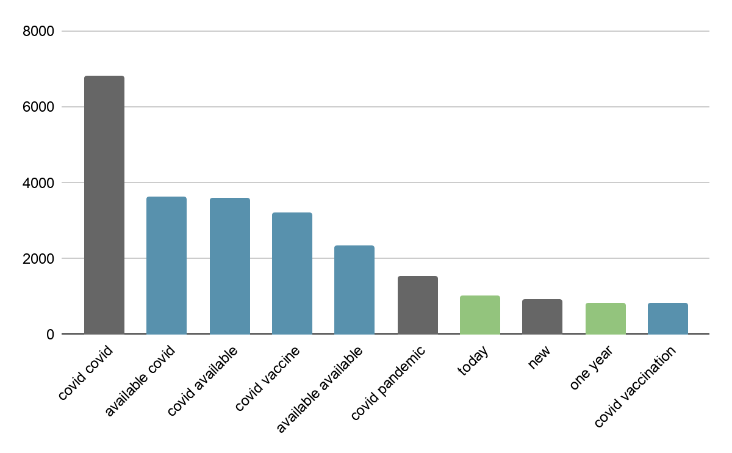
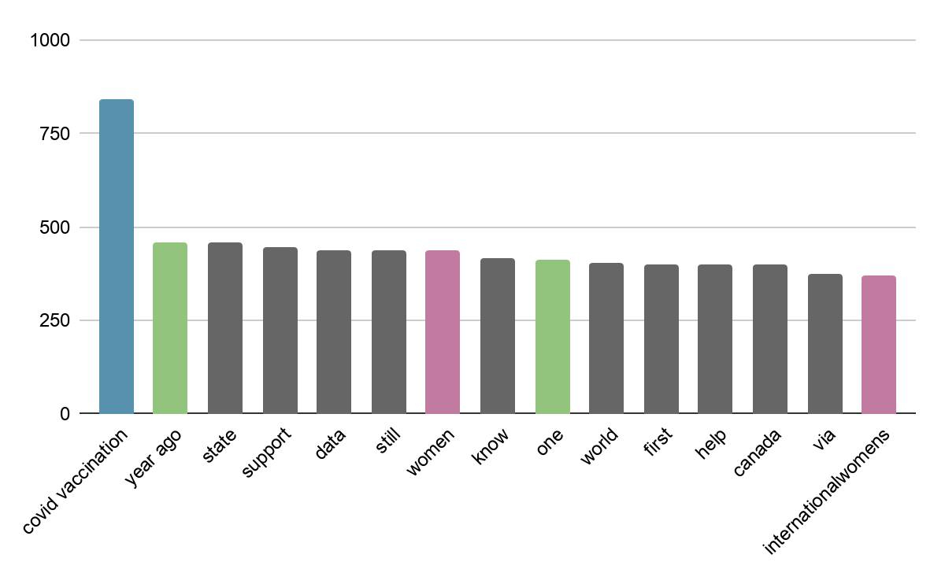
Top Phrases
Trending Topics:
Vaccine
One Year Anniversary
Women

Slide 11
Trending COVID Topics
Vaccine
One Year Anniversary
Women
The COVID-19 pandemic is changing rapidly and requires different strategies to maintain clinical preventive services, including immunization. We analyze how people feel about the vaccines
Last March, the COVID-19 pandemic became a real threat to the United States. Because it is about one year since then, this has been a trending topic in our tweets.
International Women’s Day is 3/8 and many tweets this year highlighted women’s roles in the pandemic.

Slide 12
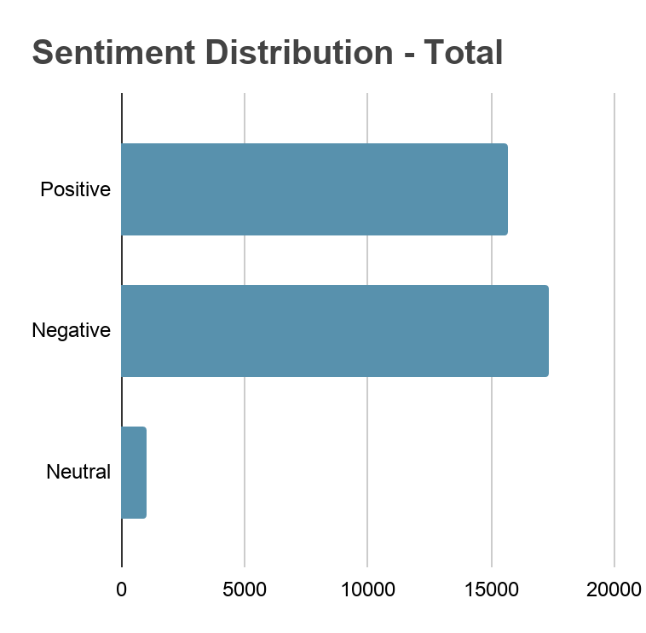
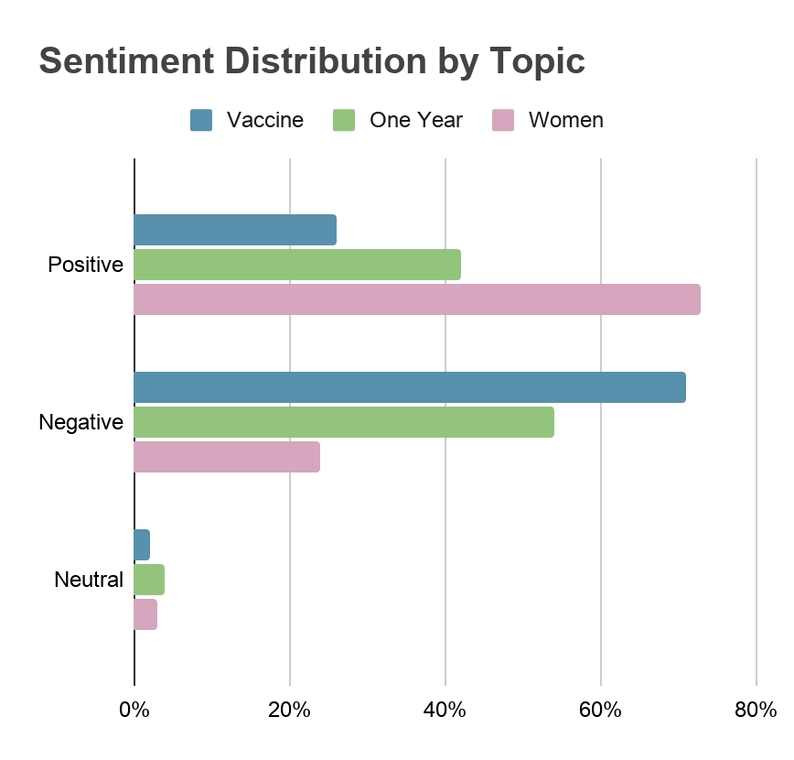
OVERALL SENTIMENT
Utilized sentimentdl_use_twitter model from Spark NLP to analyze sentiment of COVID tweets

Slide 13
05
COVID Vaccine Analysis

Slide 14
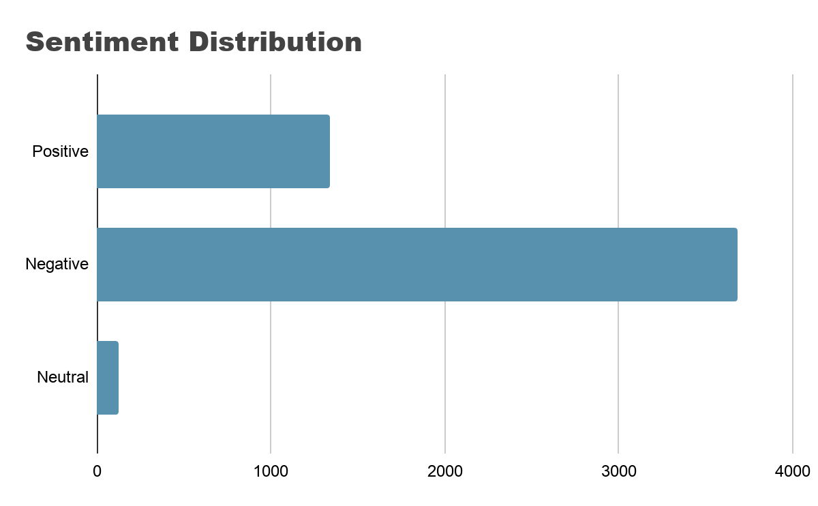
COVID-19 Vaccines
71% of the tweets showed negative sentiment regarding the the vaccine. People talking about CDC, vaccinated people can still transmit COVID-19 and the different vaccine brands.
Only 26 % of the tweets regarding the vaccine are positives. People talking about registration and new authorized locations to administer the vaccine

Slide 15
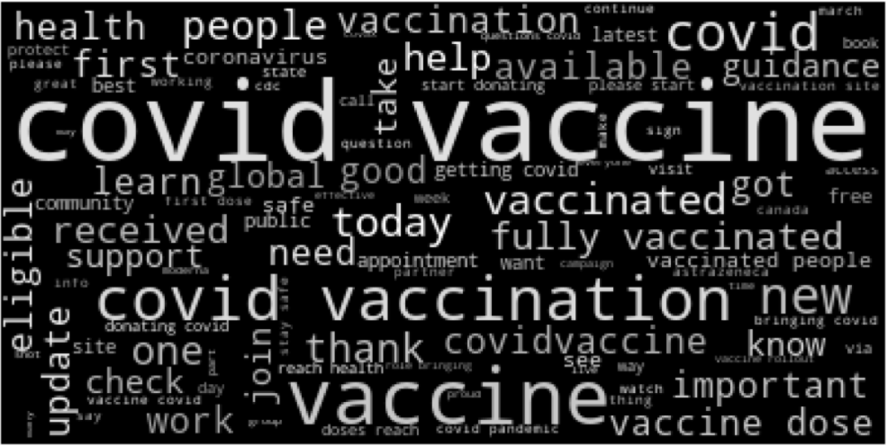
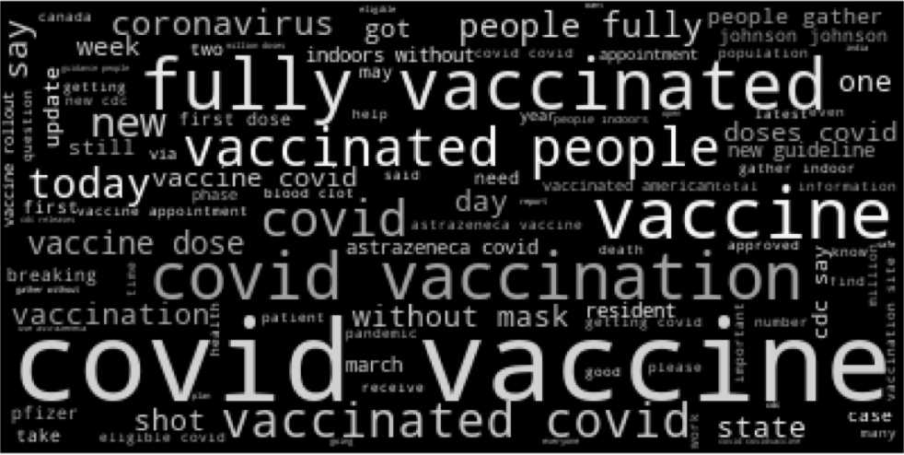
COVID-19 Vaccine
POSITIVE THEMES
NEGATIVE THEMES
We see similarities for both the negative and positive sentiments for this topic. Some people feel hopeful about the vaccines and others are not happy/confident about the vaccination process.

Slide 16
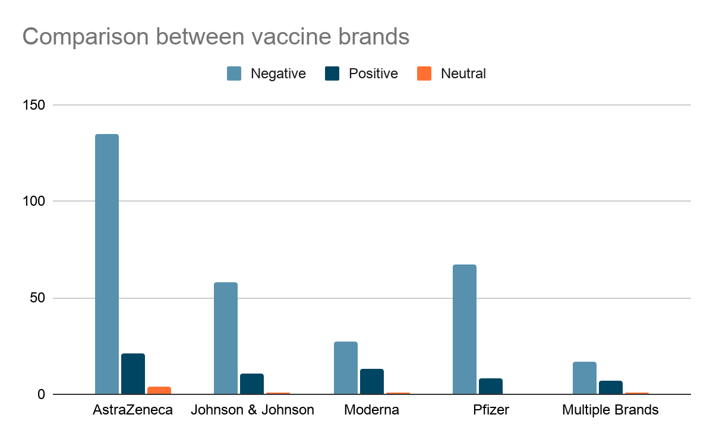
COVID-19 Vaccine - Comparing Brands
Pfizer has the worst % of negative tweets with 89% followed by AstraZeneca with 84 %, Johnson & Johnson with 83 % and finally Moderna with 66 %. When people talk about multiple brands we see a 68 % negative tweets.

Slide 17
06
COVID-19 One Year
Anniversary Analysis

Slide 18
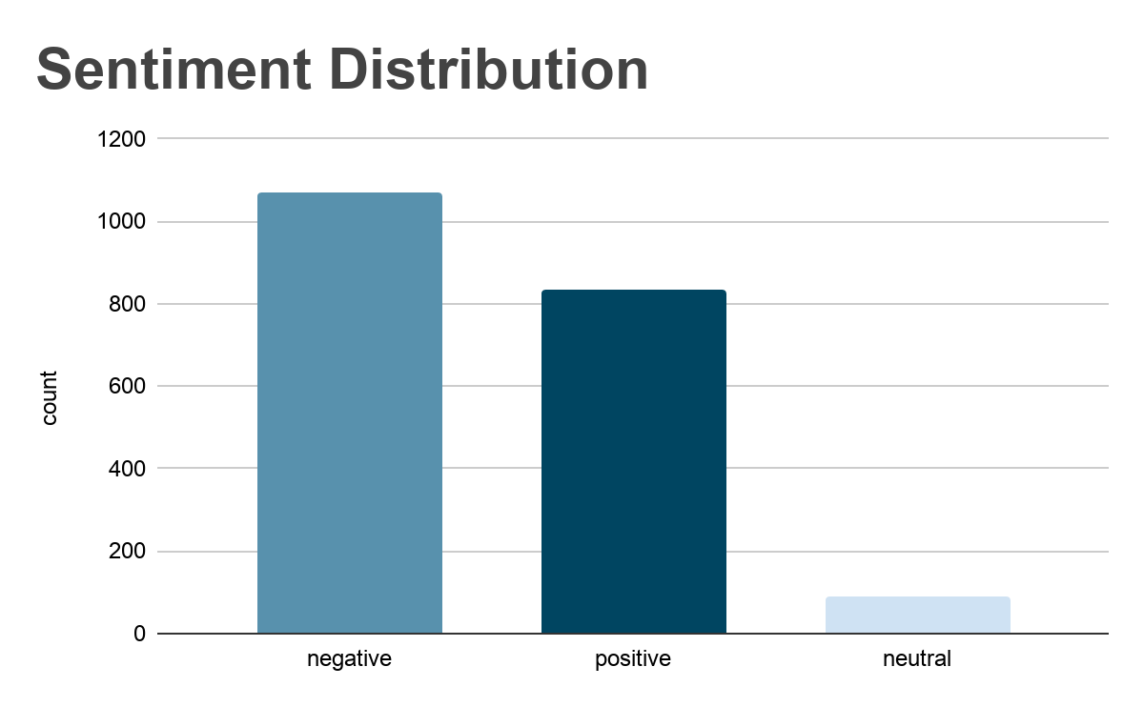
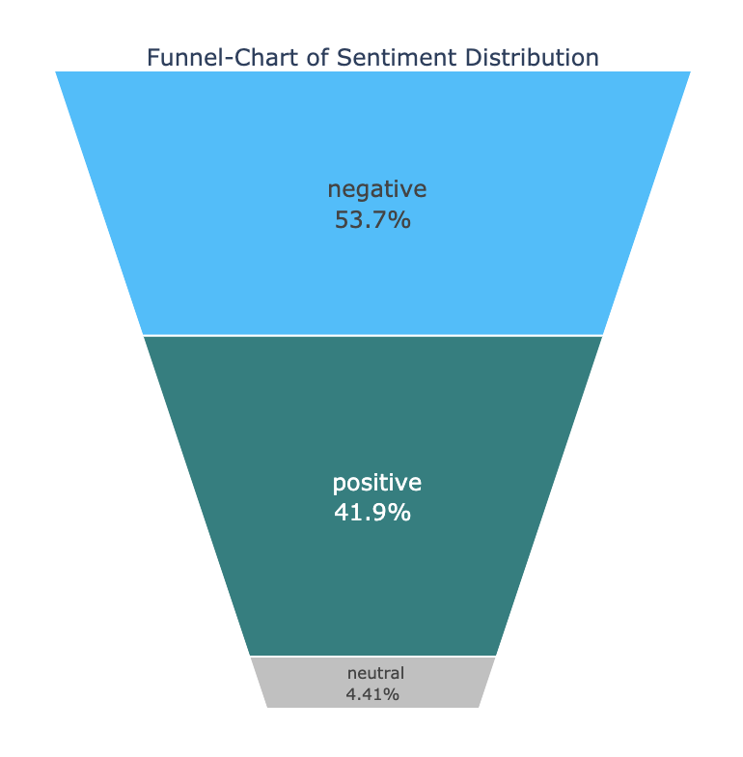
One Year Anniversary of COVID-19 - Sentiment
Most of the tweets showed negative sentiment regarding the one year anniversary
There are almost as many positives (1072 negative versus 835 positive)

Slide 19
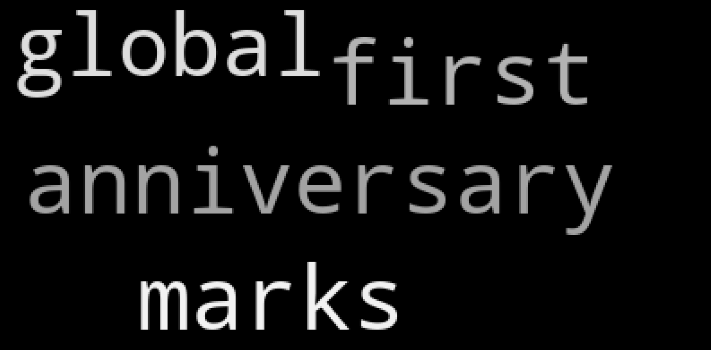
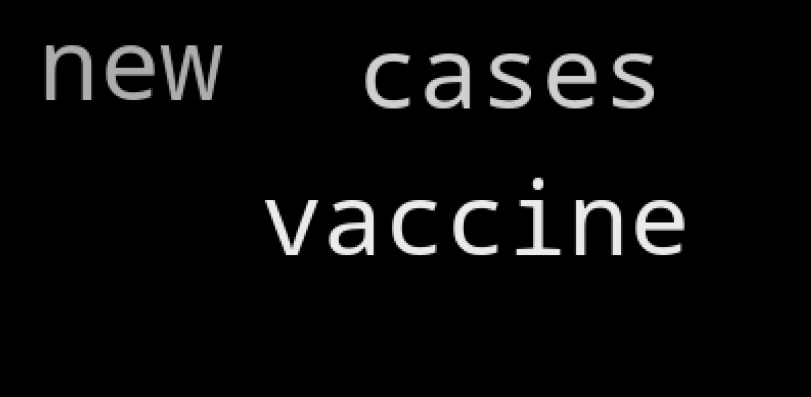
One Year Anniversary of COVID-19 - Insights
POSITIVE TOPICS
NEGATIVE TOPICS
Progress made since last year.
Global-coming together
People on twitter are feeling hopeful
People are feeling negative about the vaccine
Numbers of new cases

Slide 20
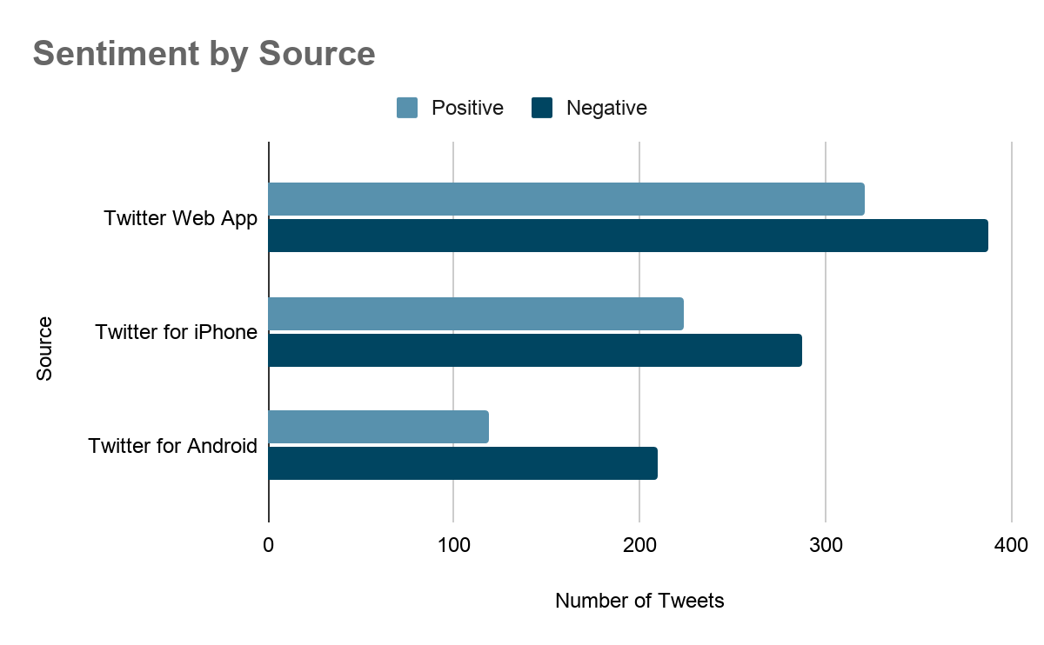
One Year Anniversary of COVID-19 - Insights
Here we have the tweets for this topic grouped by the 3 most popular sources
For each source, there are more tweets with a negative sentiment than a positive sentiment
This tells us that no matter the source, tweets for this topic will trend negative

Slide 21
07
Women & COVID Analysis

Slide 22
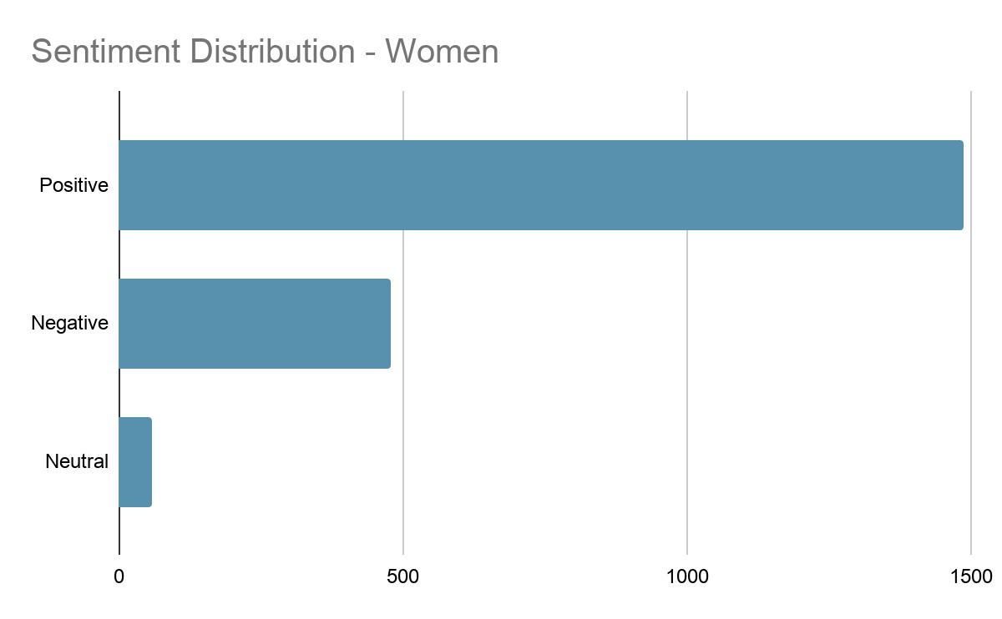
Women & COVID - Sentiment
Majority of the tweets showed positive sentiment celebrating the holiday
Negative tweets discussed gender inequality and how the pandemic has disproportionately impacted women
No differences in sentiment distribution when split by location, # of tweets, or verification status

Slide 23
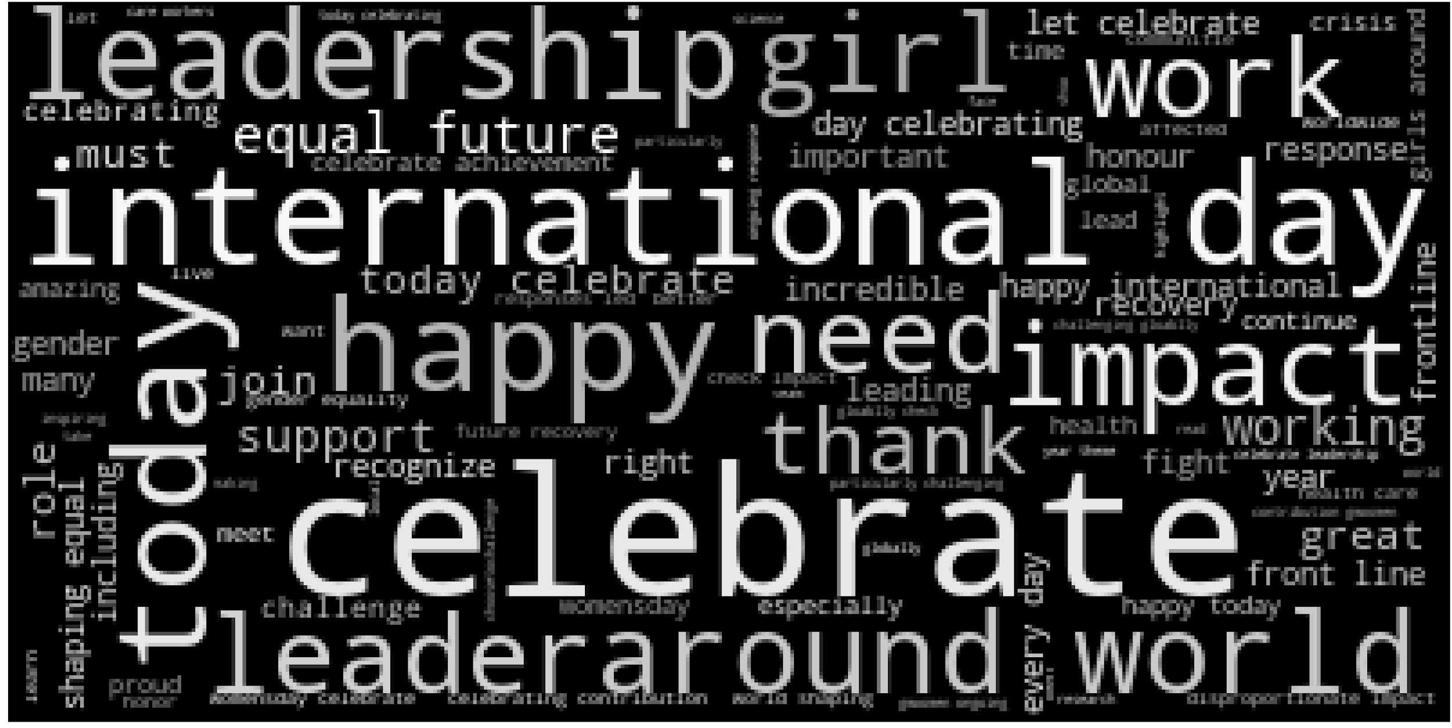
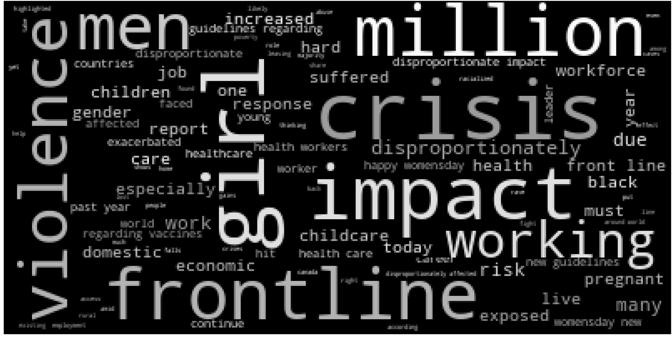
Women & COVID - Insights
POSITIVE THEMES:
Celebrating & thanking women for their work fighting COVID-19
Recognizing women leaders and their response during pandemic
NEGATIVE THEMES:
Increase in domestic violence
Disproportionate impact to women’s income and jobs compared to men

Slide 24
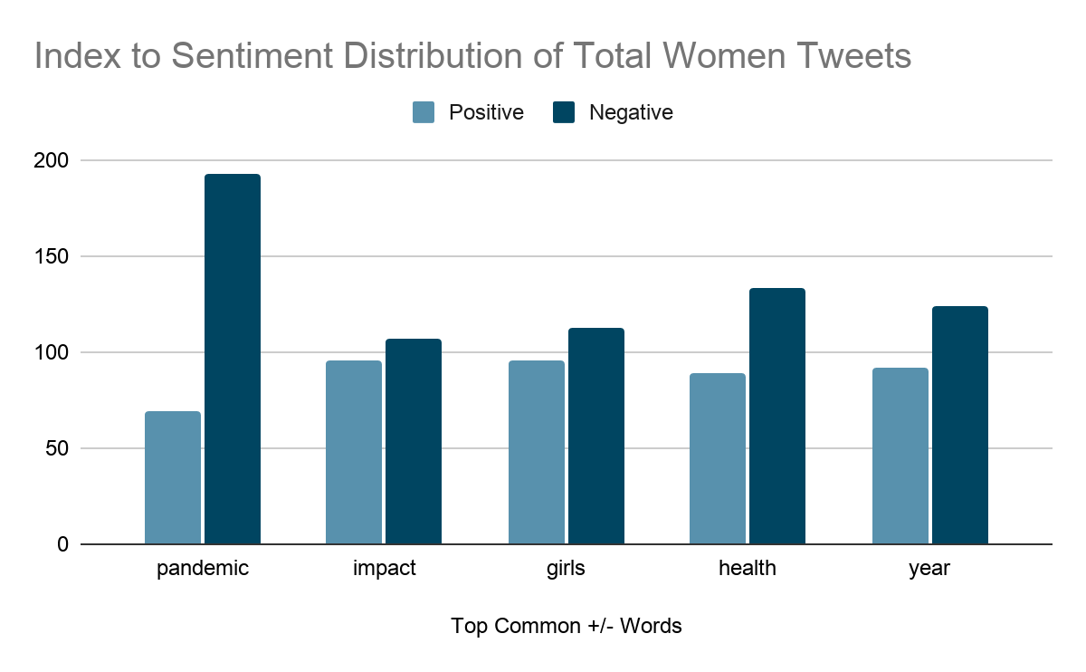
Women & COVID - Insights
Tweets containing pandemic, health, & year tend to skew negative

Slide 25
Thank You!
Questions?

